Slide 1
Session 2020-21 CSTE-3101 Communication Engineering

Slide 2
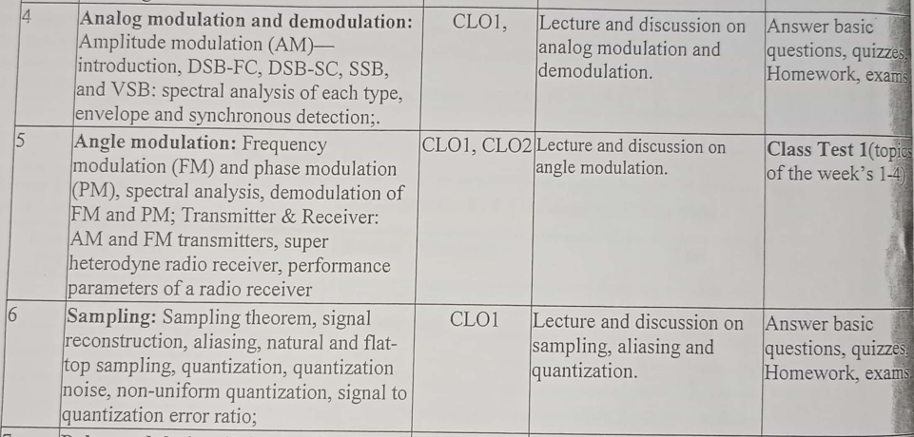
Week: 4-8

Slide 3
Vestigial Side Band (VSB) Modulation

Slide 4
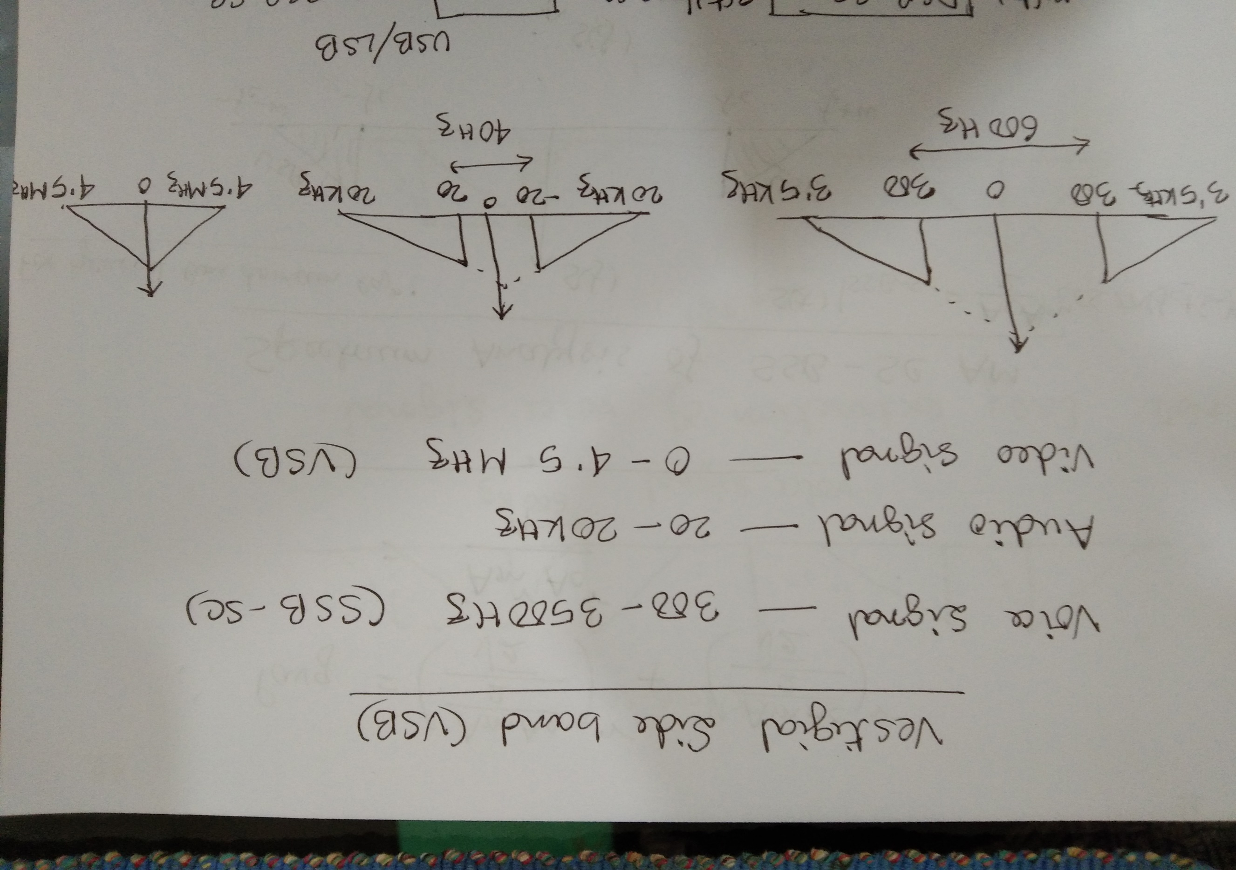

Slide 5
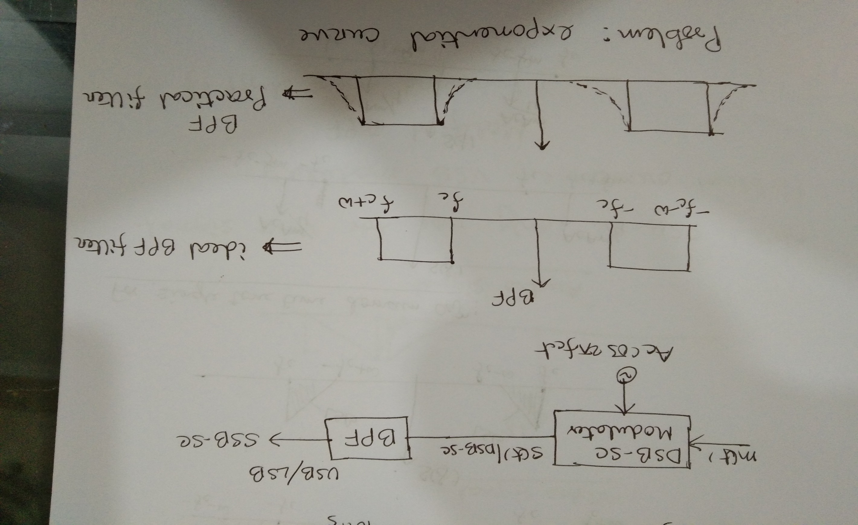

Slide 6
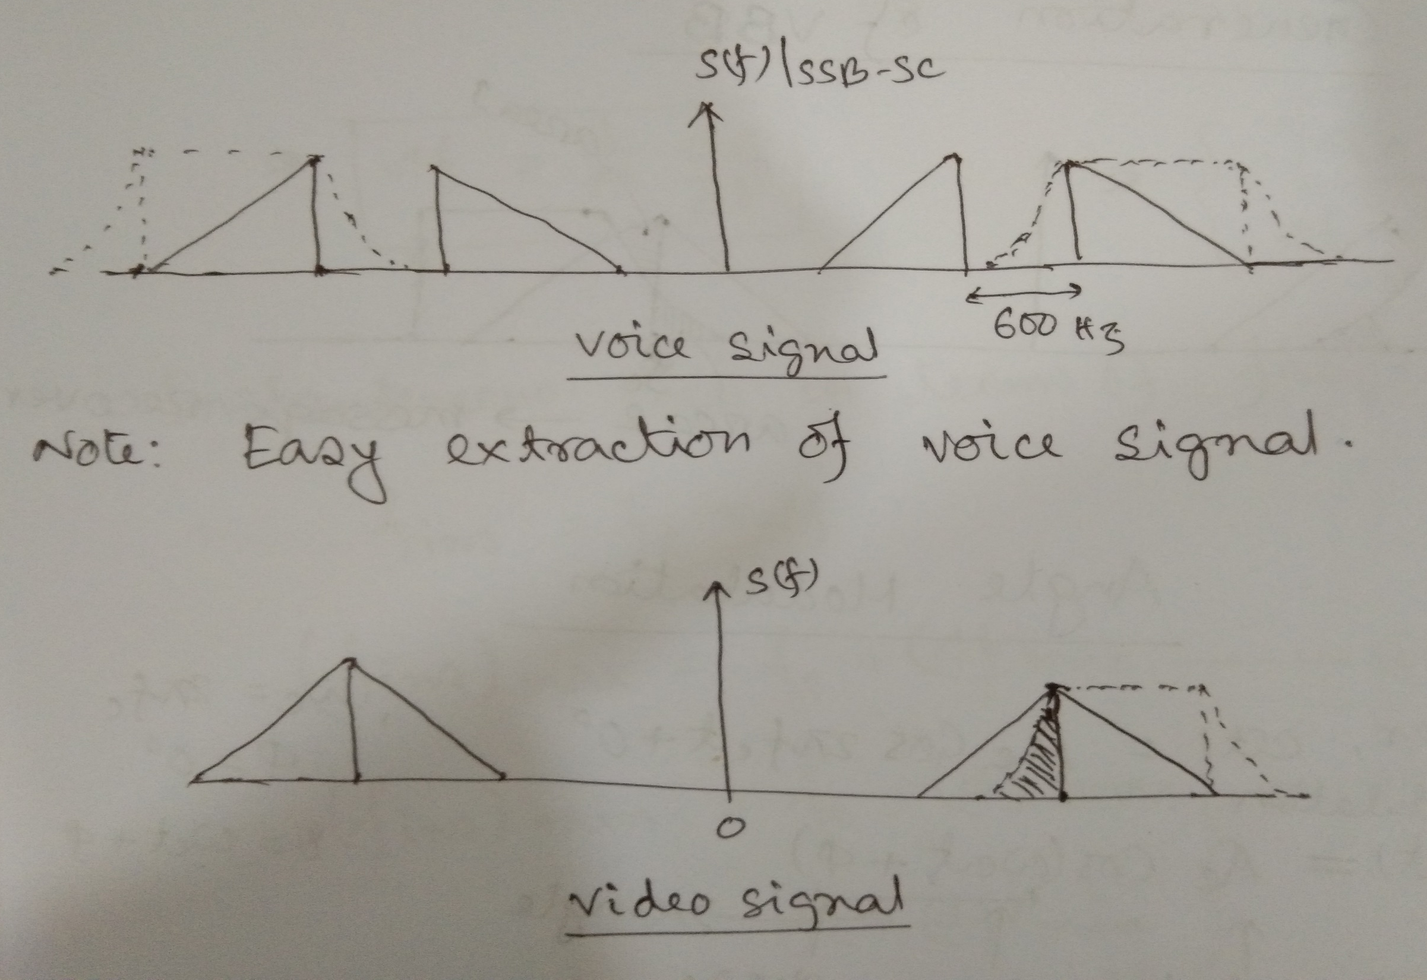

Slide 7
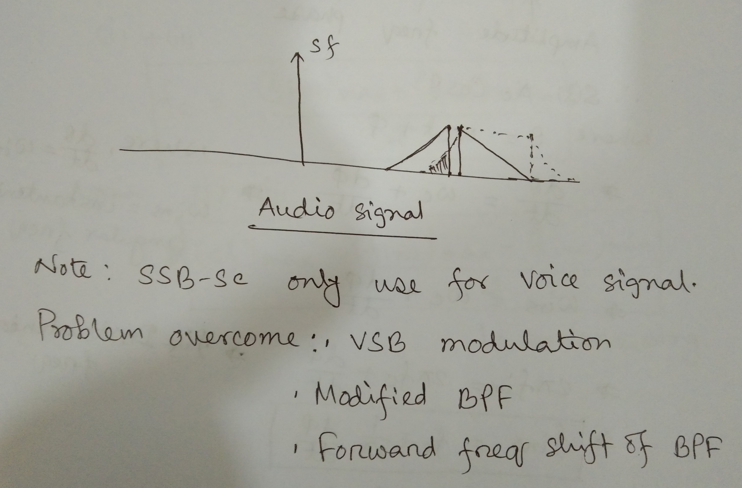

Slide 8
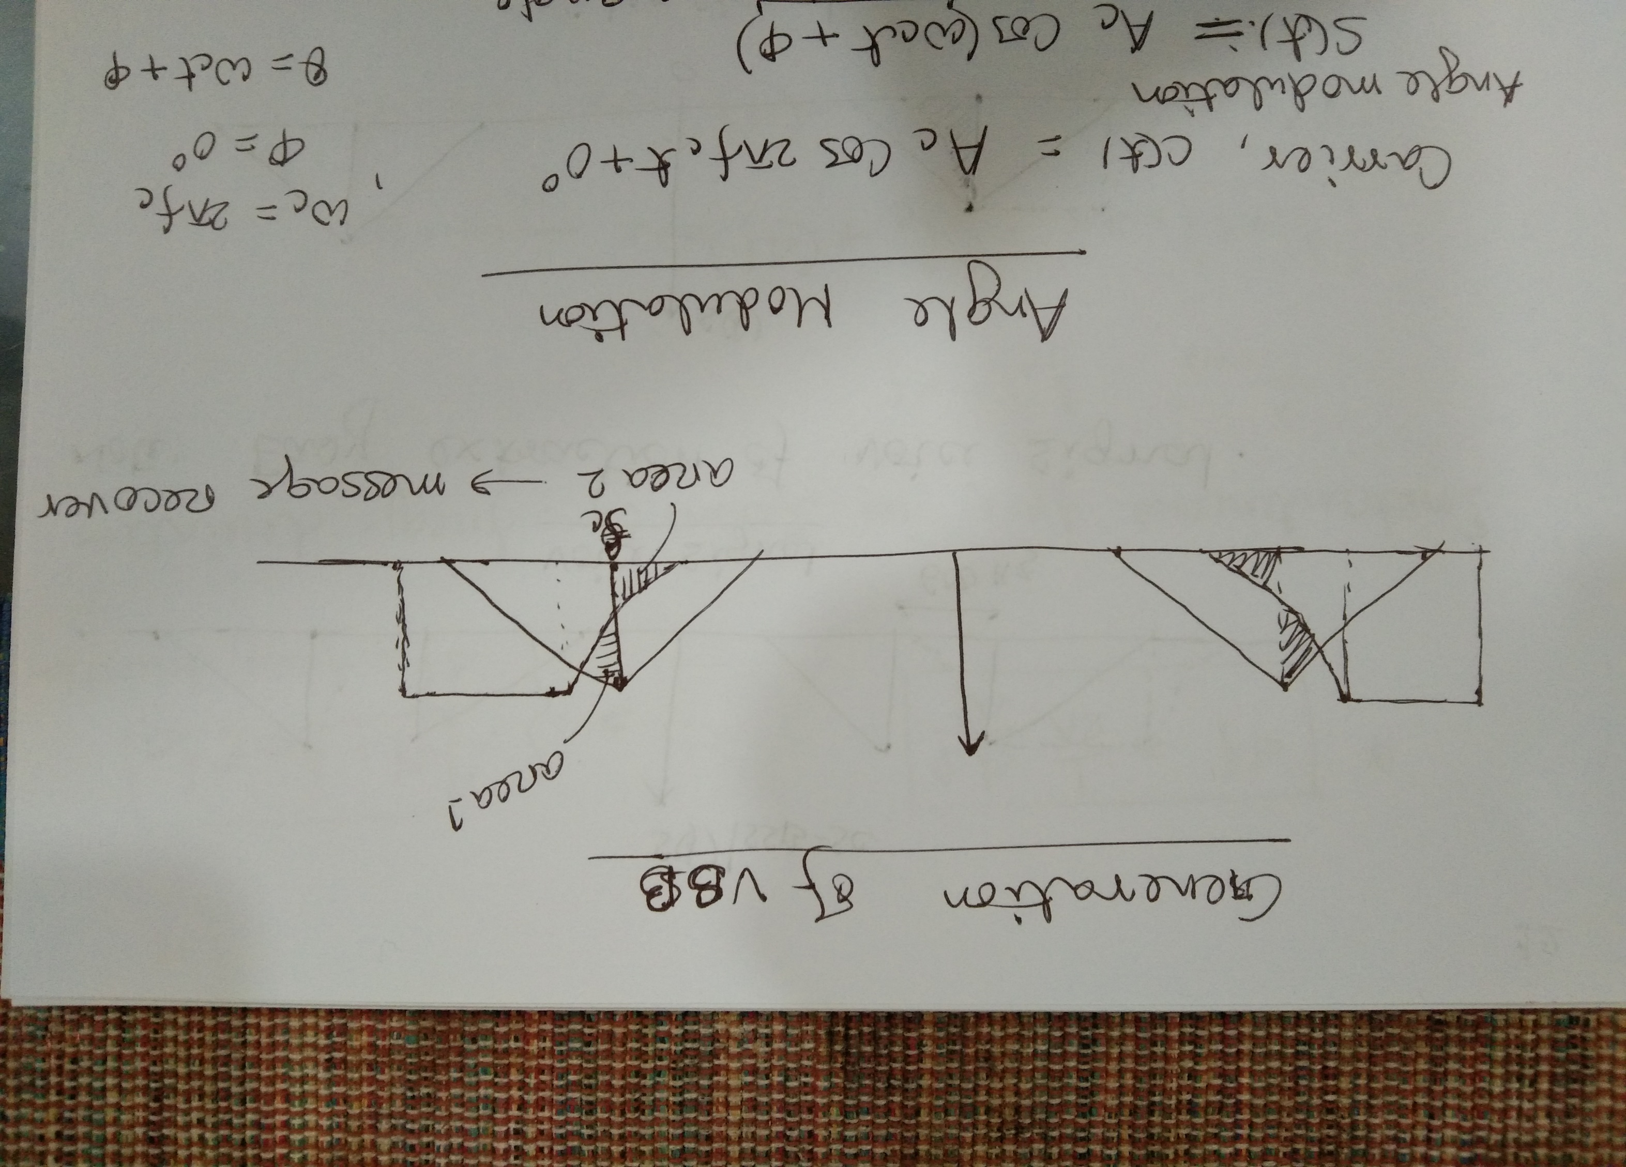

Slide 9
Demodulation

Slide 10
Demodulation of Linear Modulation (AM Signals)
Envelops Detectors
Synchronous Detection

Slide 11
Envelop Detection

Slide 12
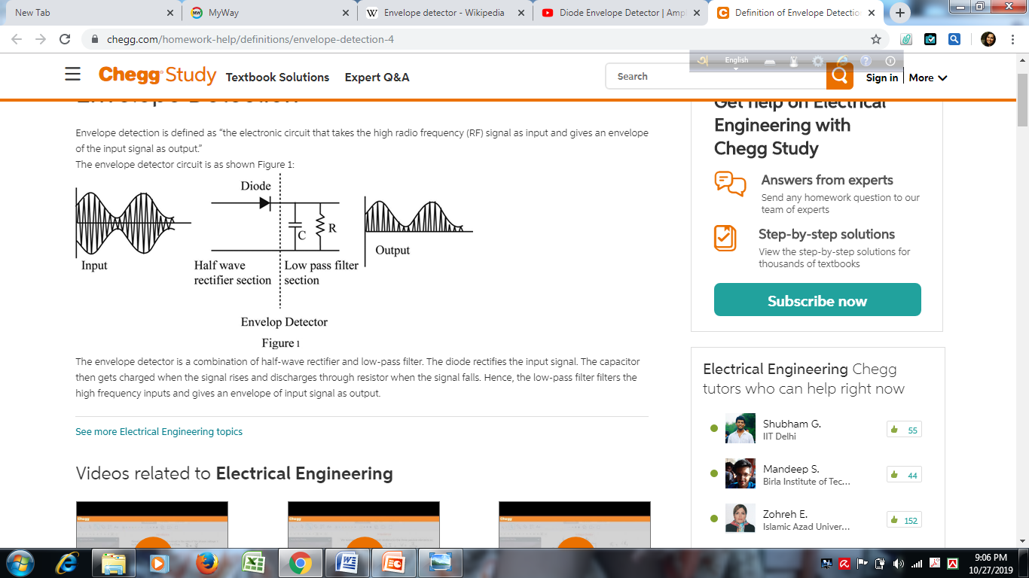
Envelope Detection

Slide 13
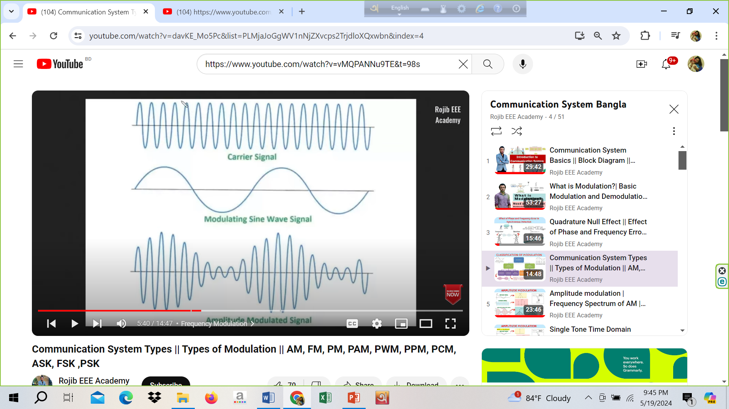
AM signal

Slide 14
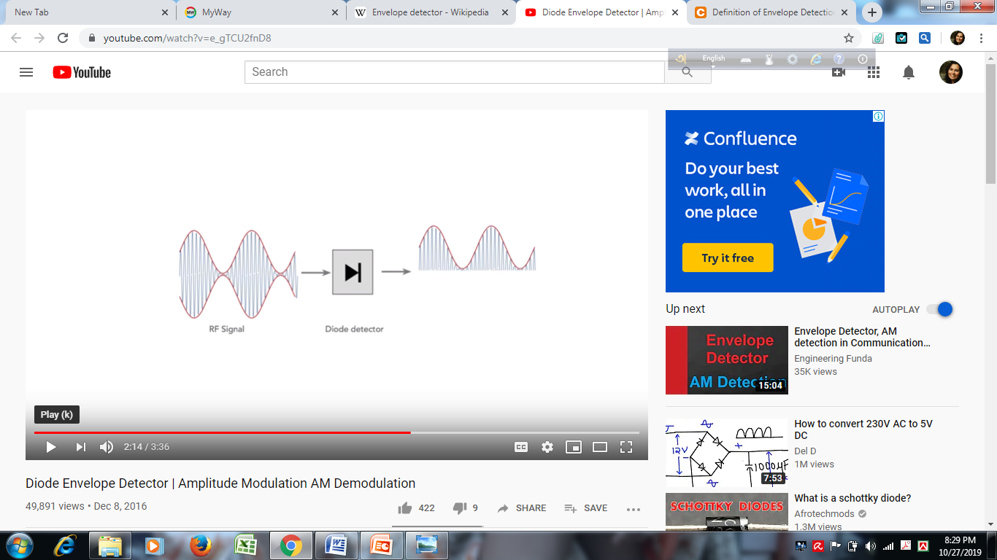
Half wave rectifier section

Slide 15
LPF section
LPF can remove the high frequency part of the modulated signal

Slide 16
Synchronous Detection

Slide 17
Synchronous Detection
AM Wave
Product Modulator
LPF
Original signal
Local Oscillator

Slide 18
Angle Modulation

Slide 19
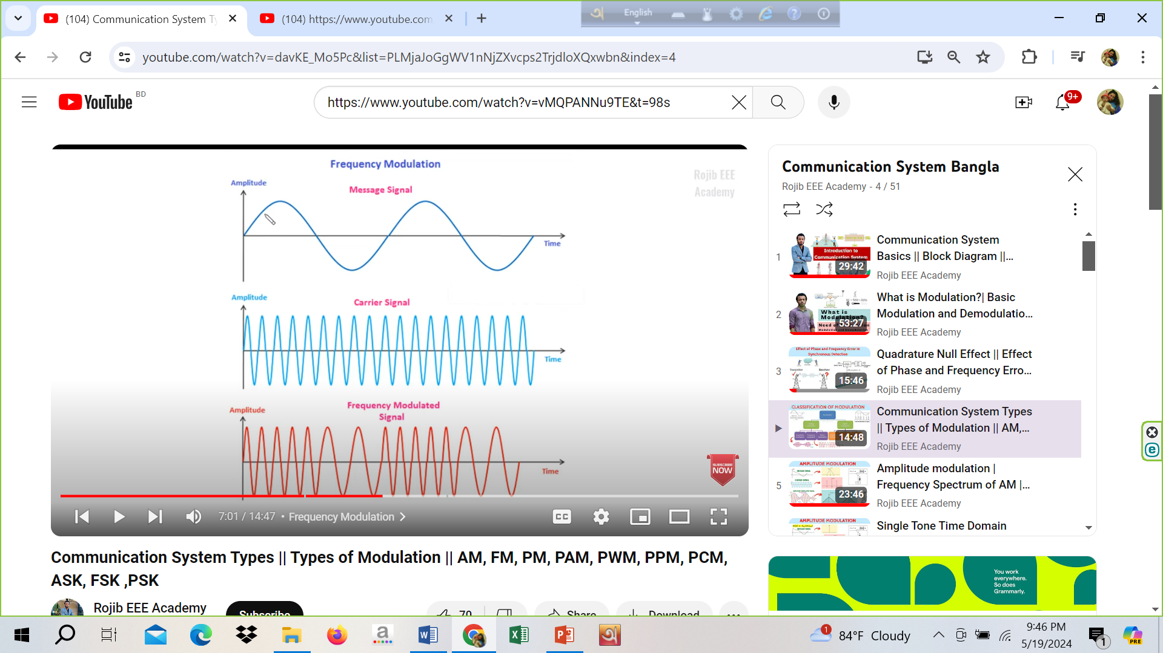

Slide 20
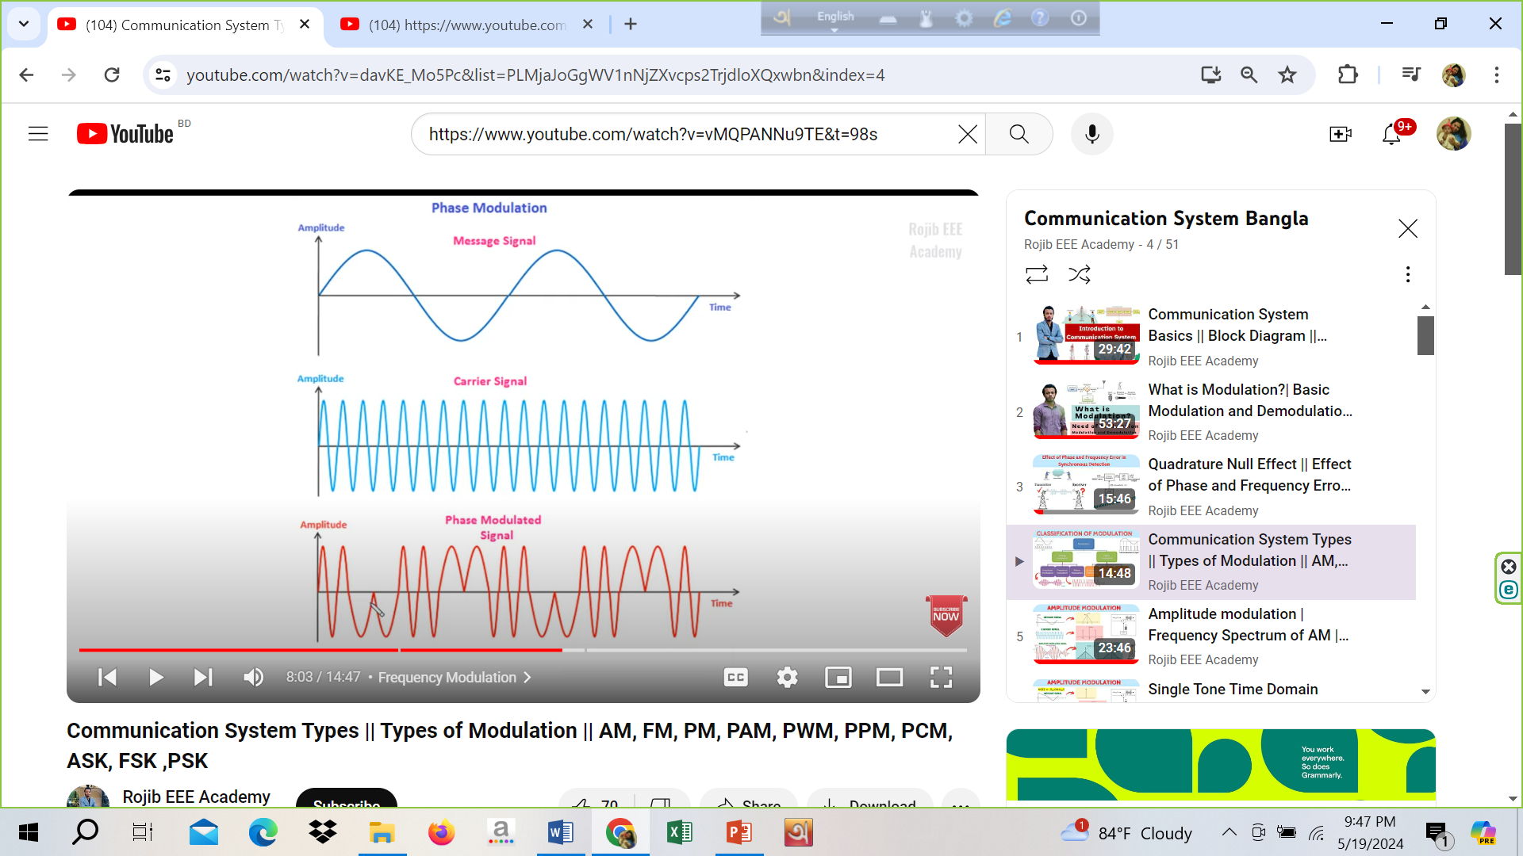

Slide 21
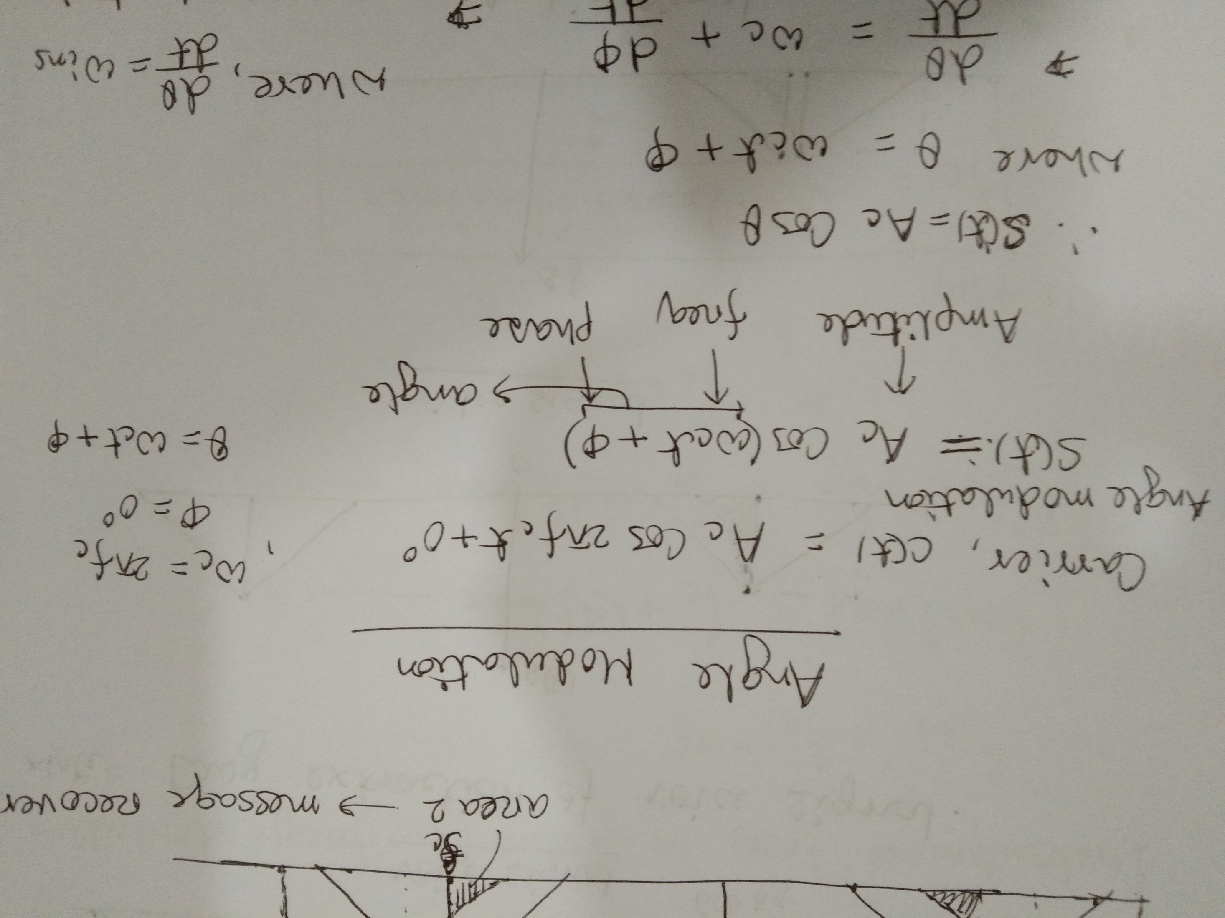

Slide 22
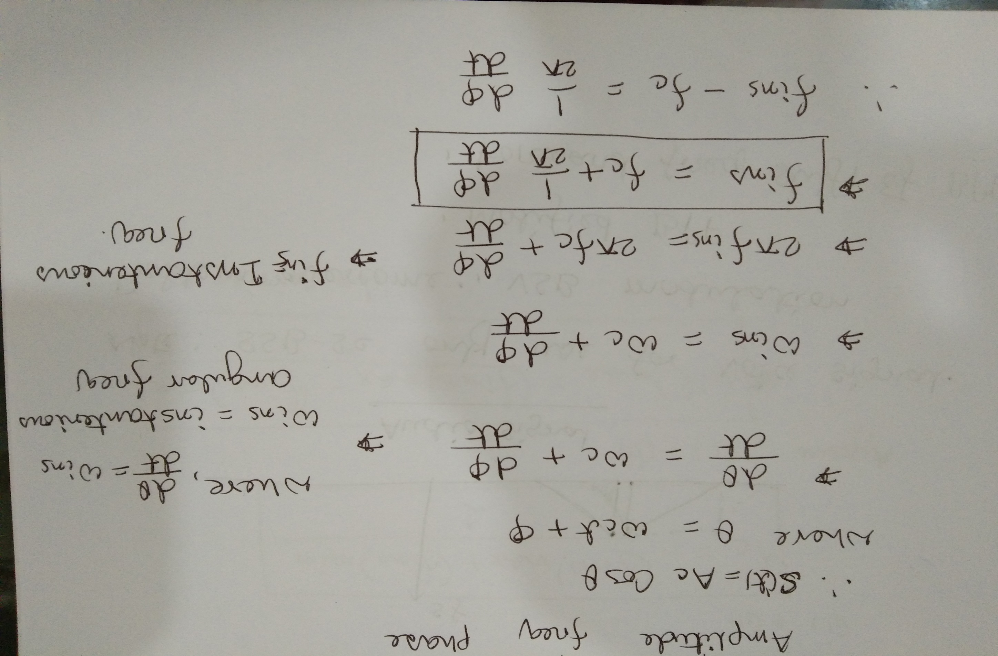

Slide 23
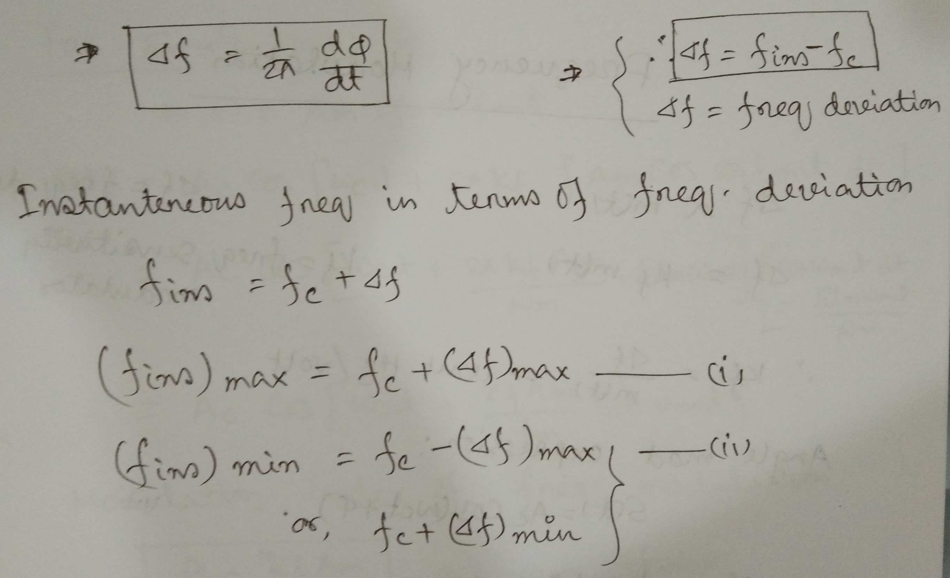

Slide 24
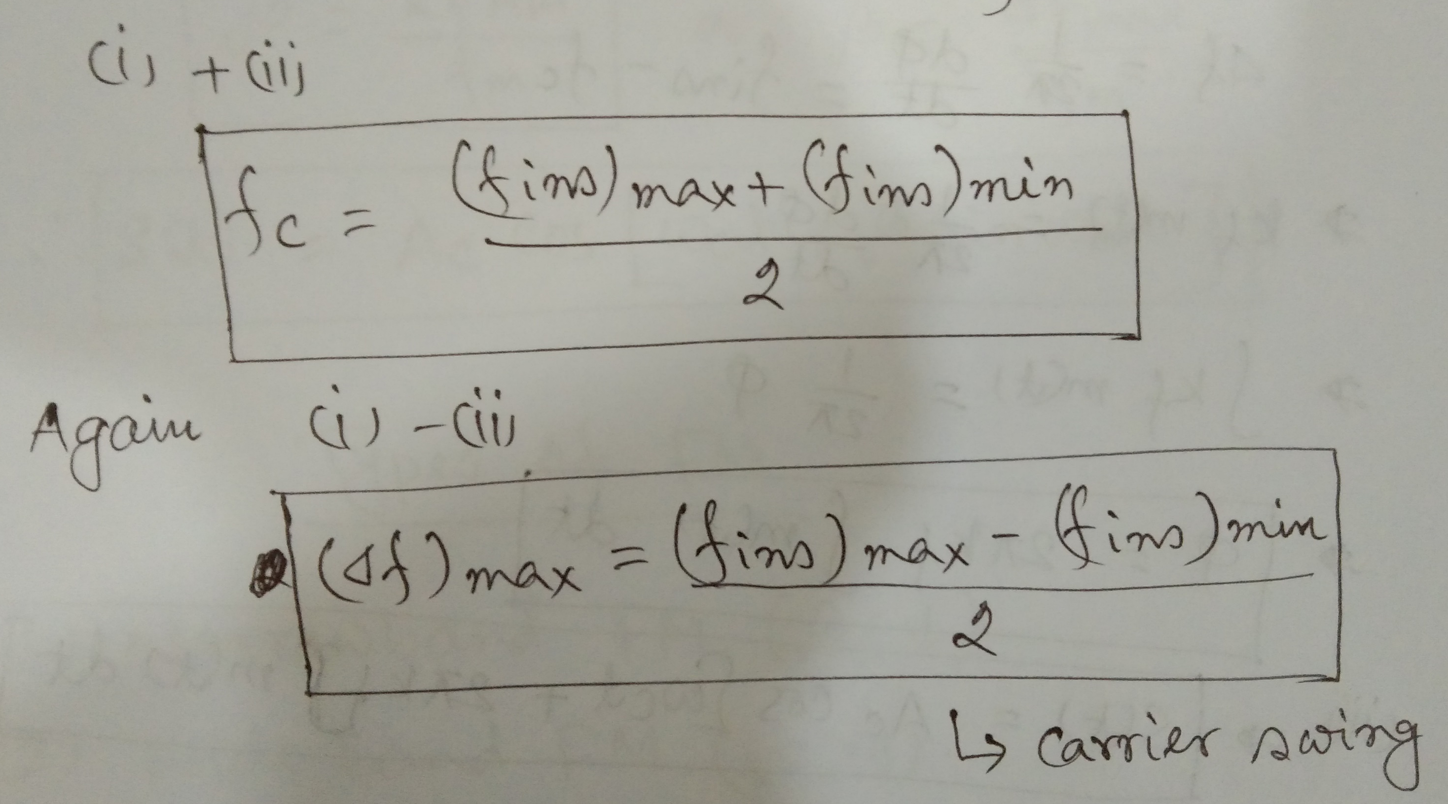

Slide 25
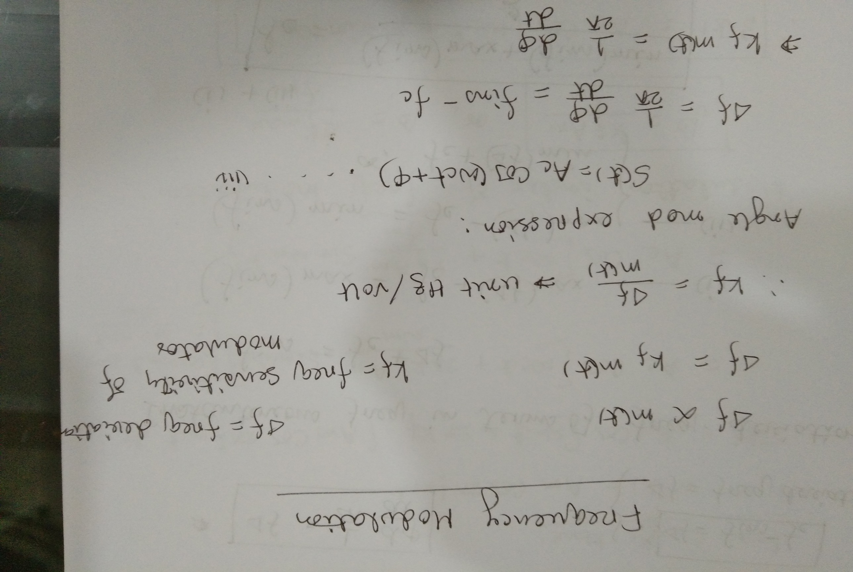

Slide 26
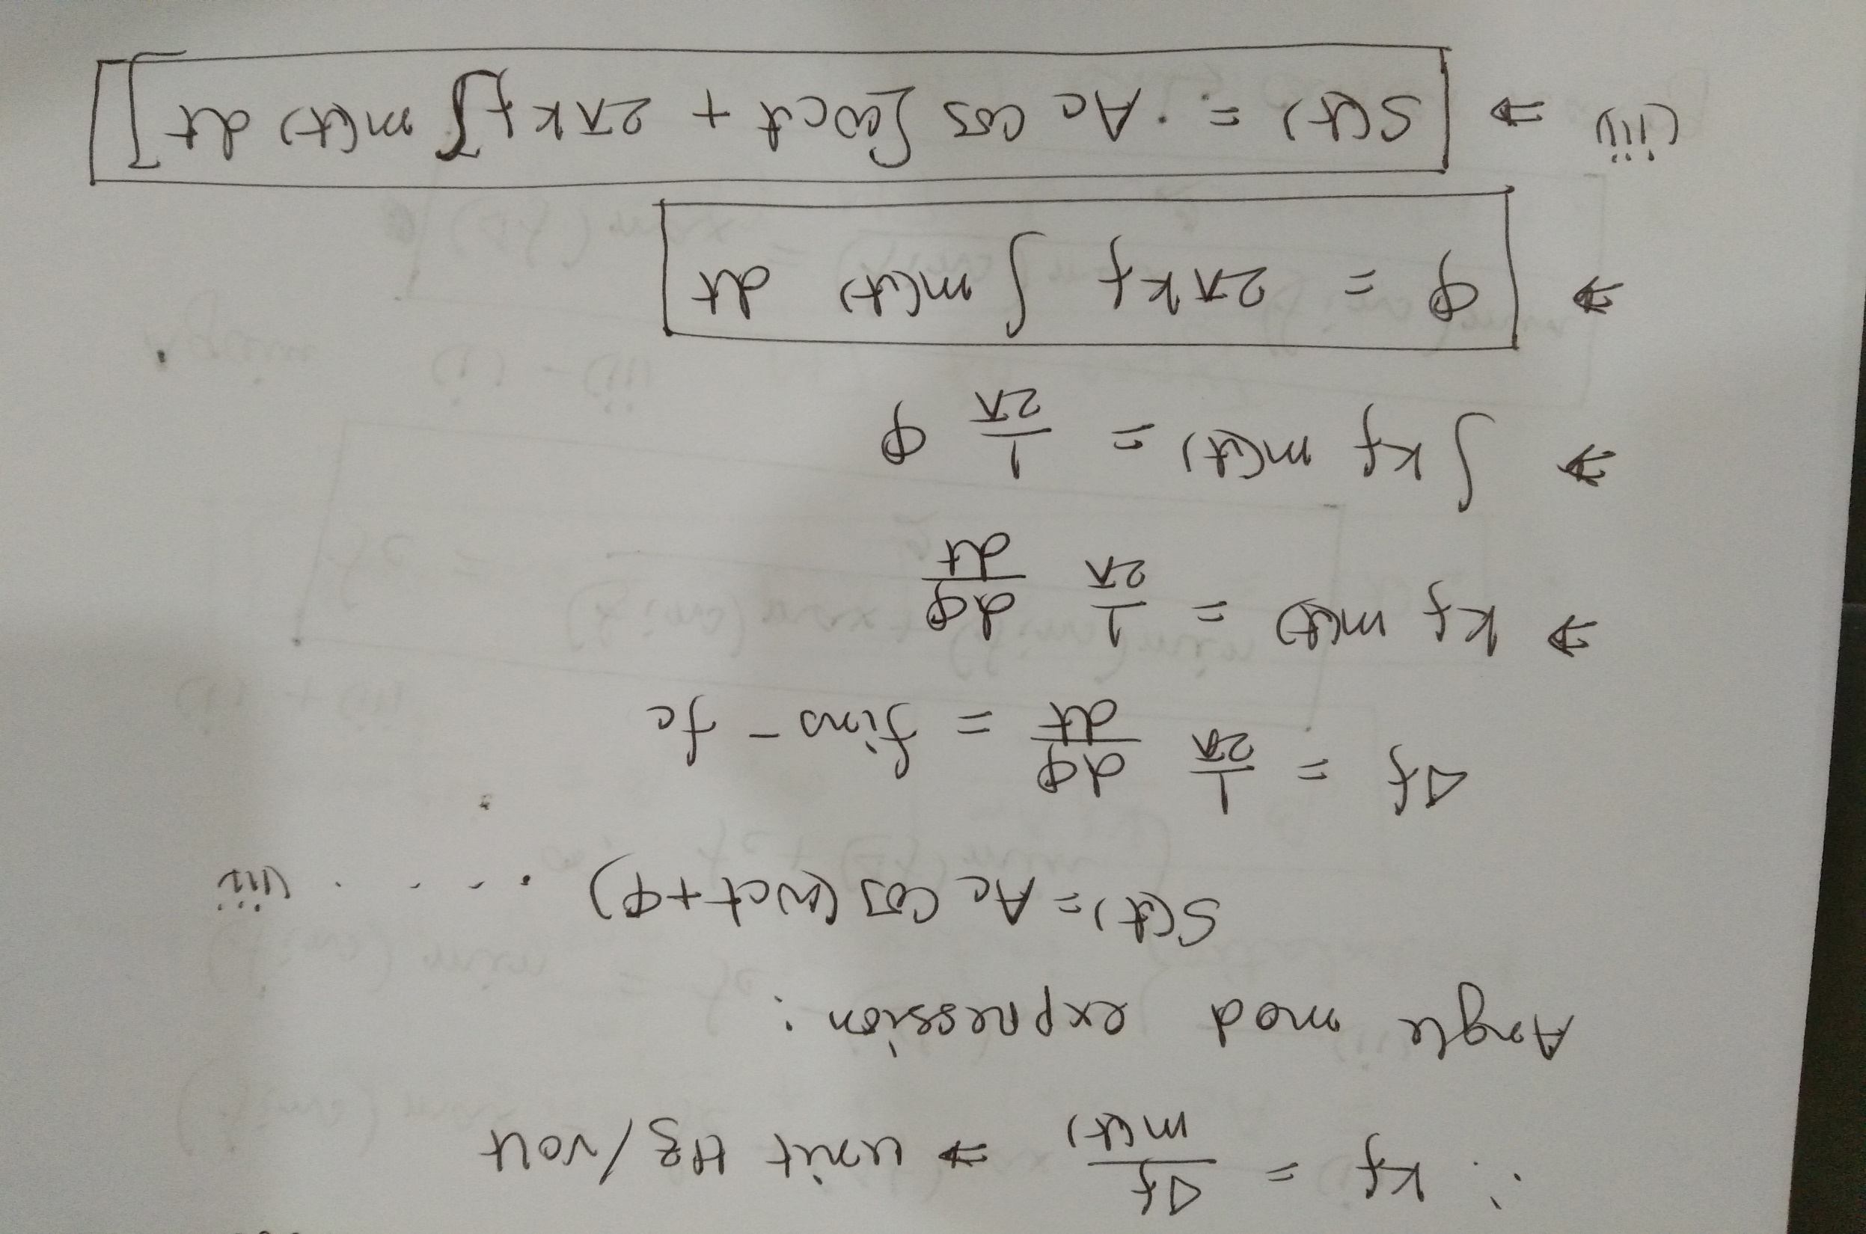

Slide 27
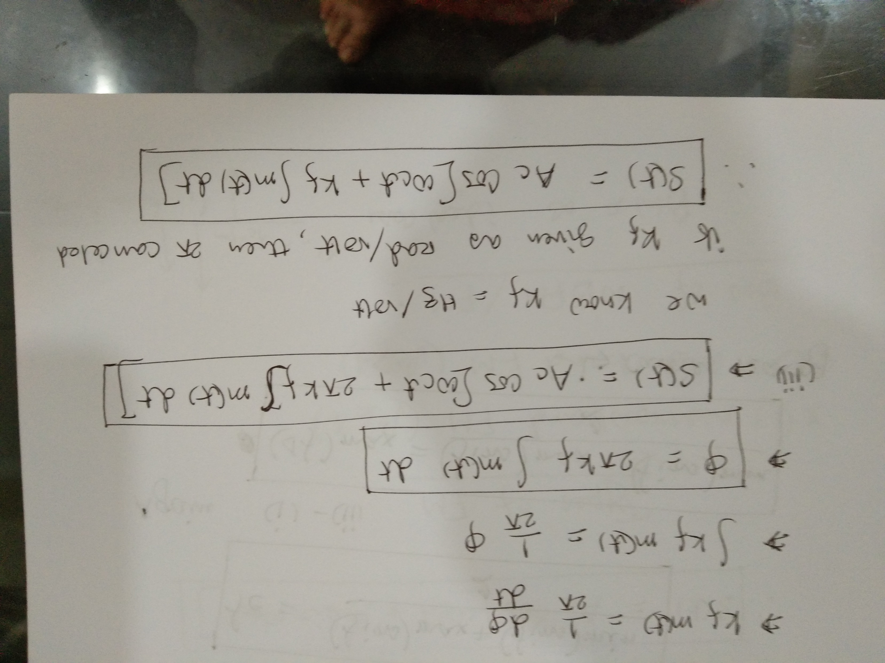

Slide 28
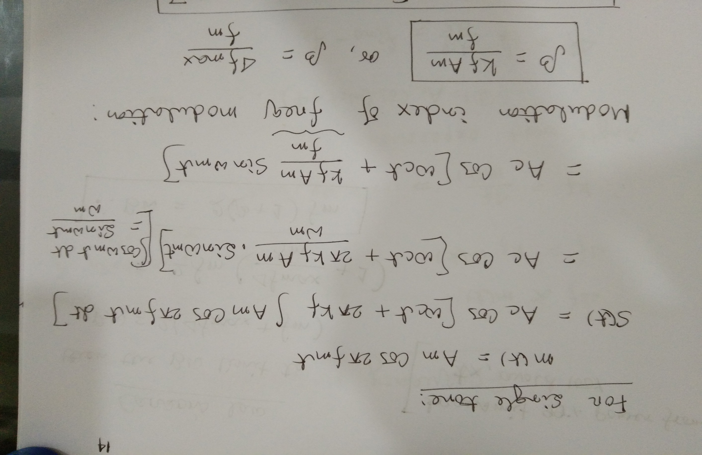

Slide 29
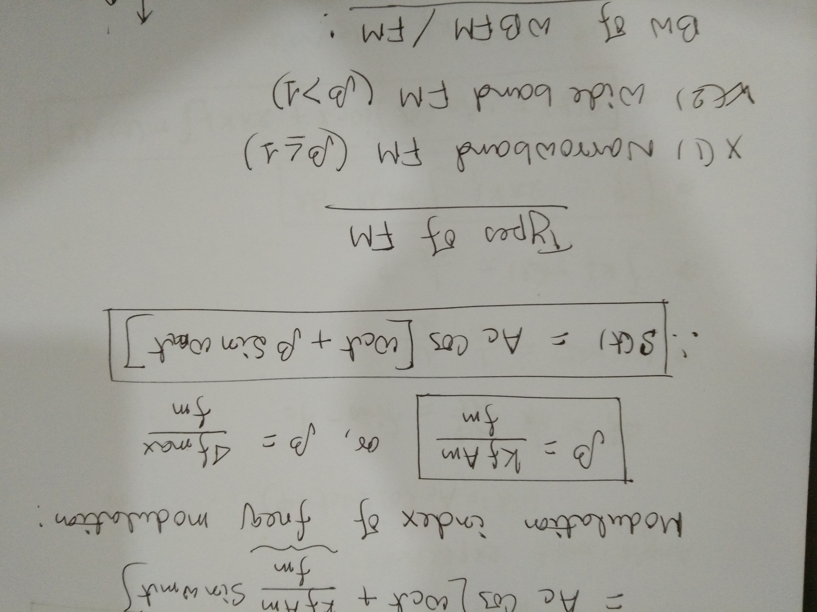

Slide 30
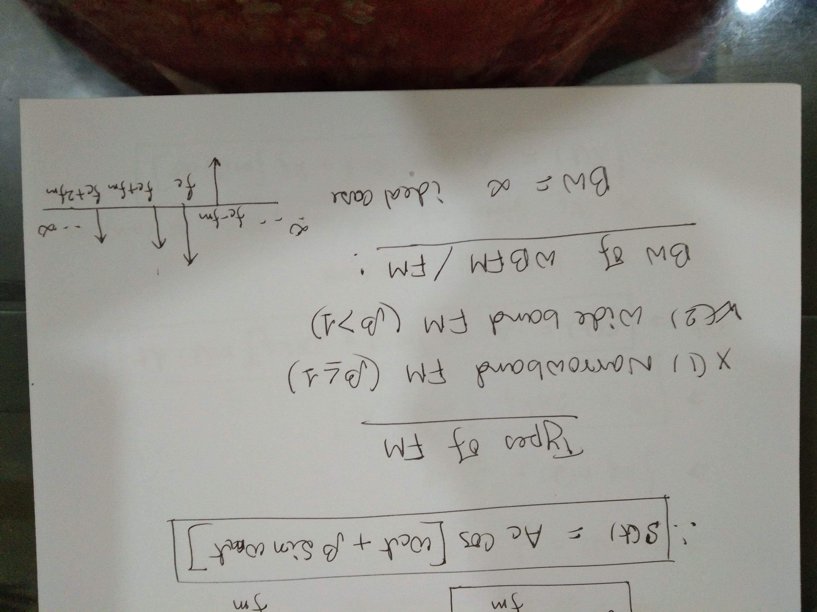

Slide 31
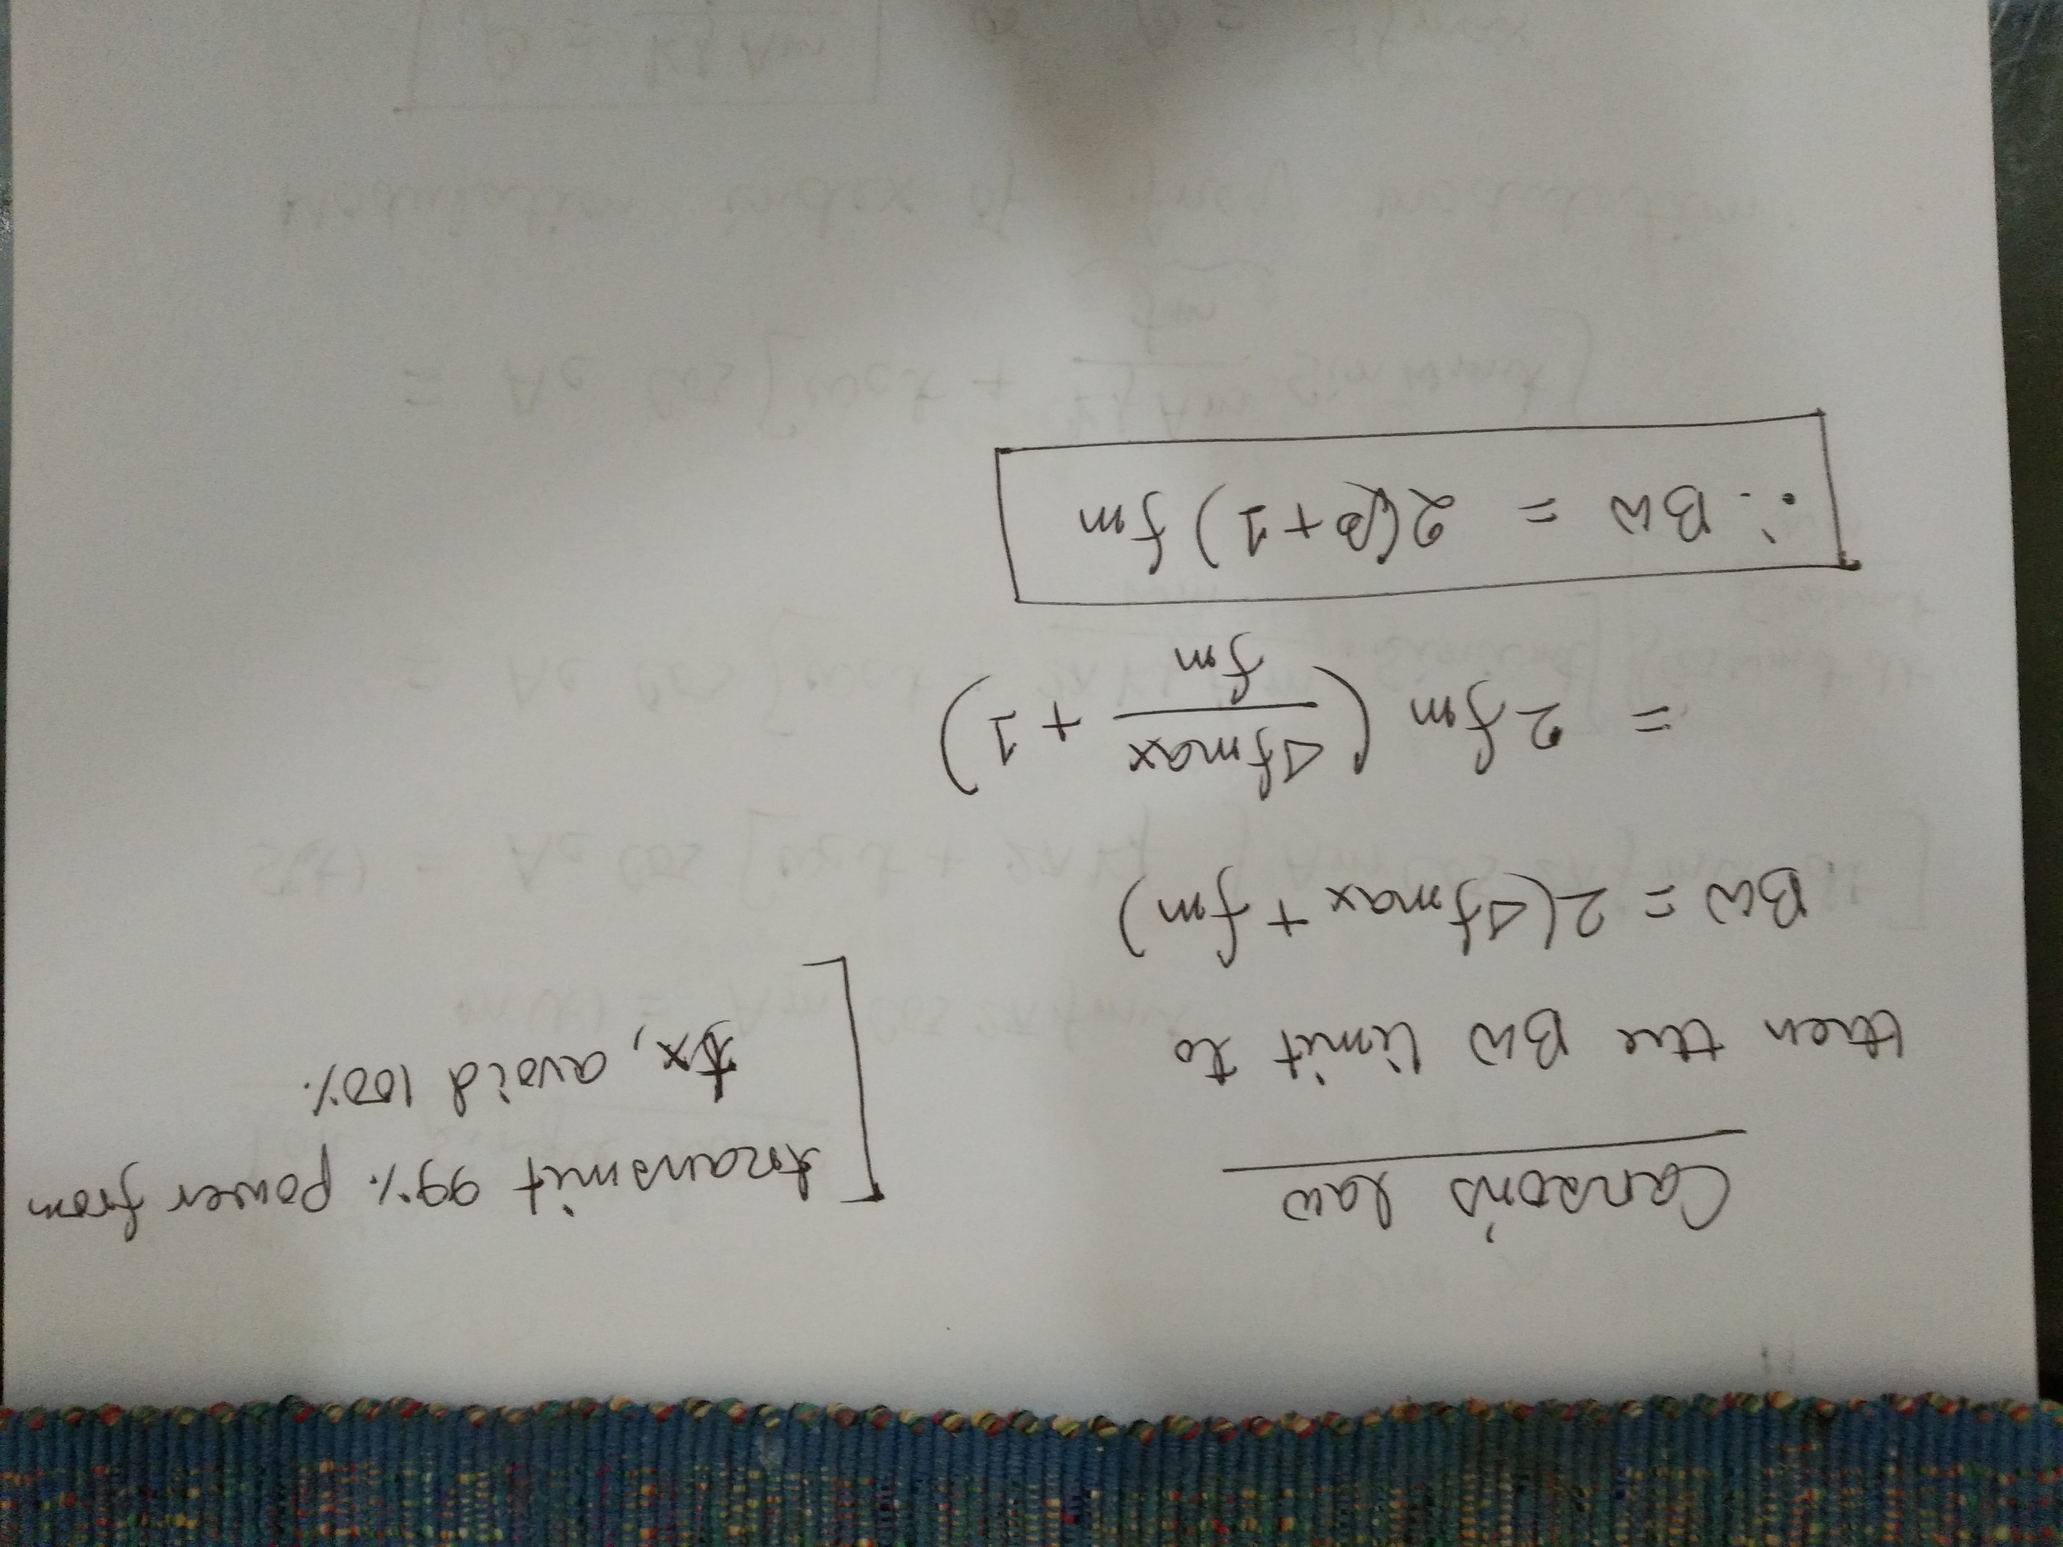

Slide 32
Example

Slide 33
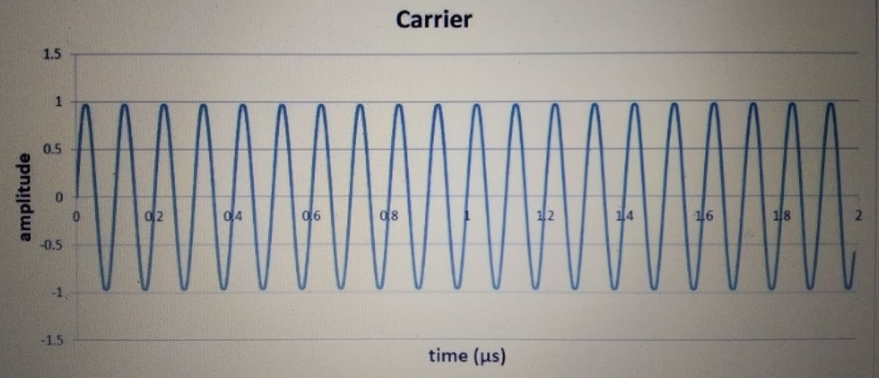
Carrier 10 MHz

Slide 34
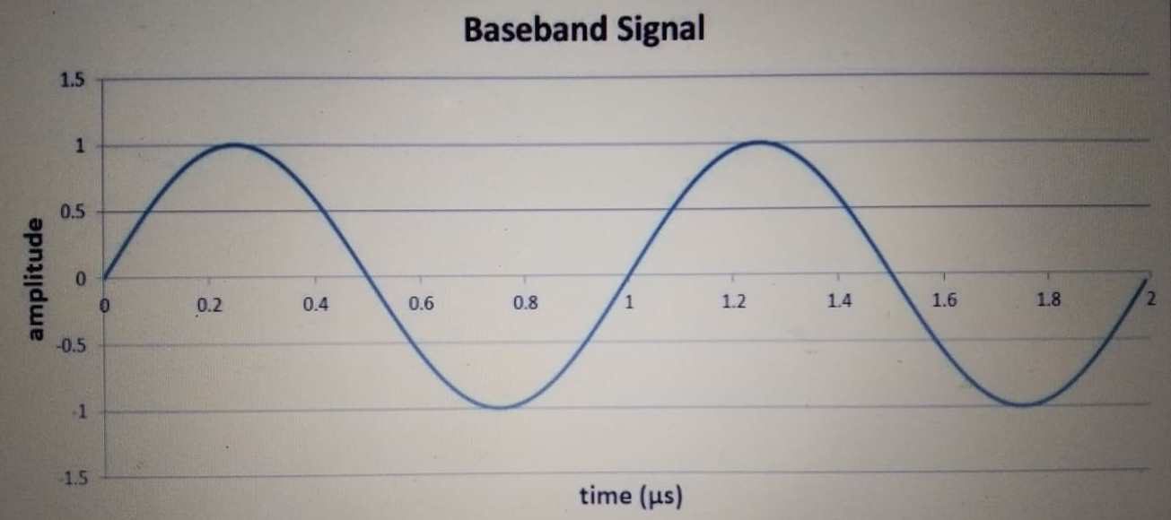
Baseband Signal 1MHz

Slide 35
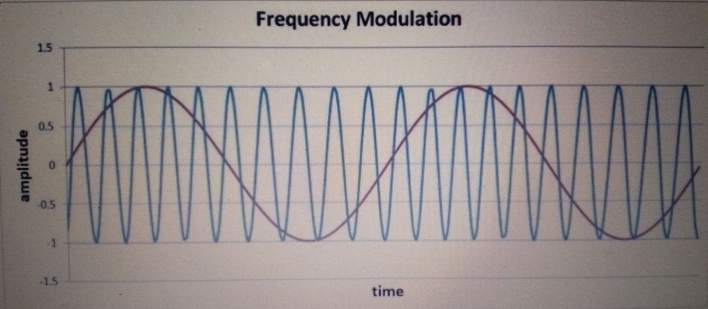
Modulation index=1

Slide 36
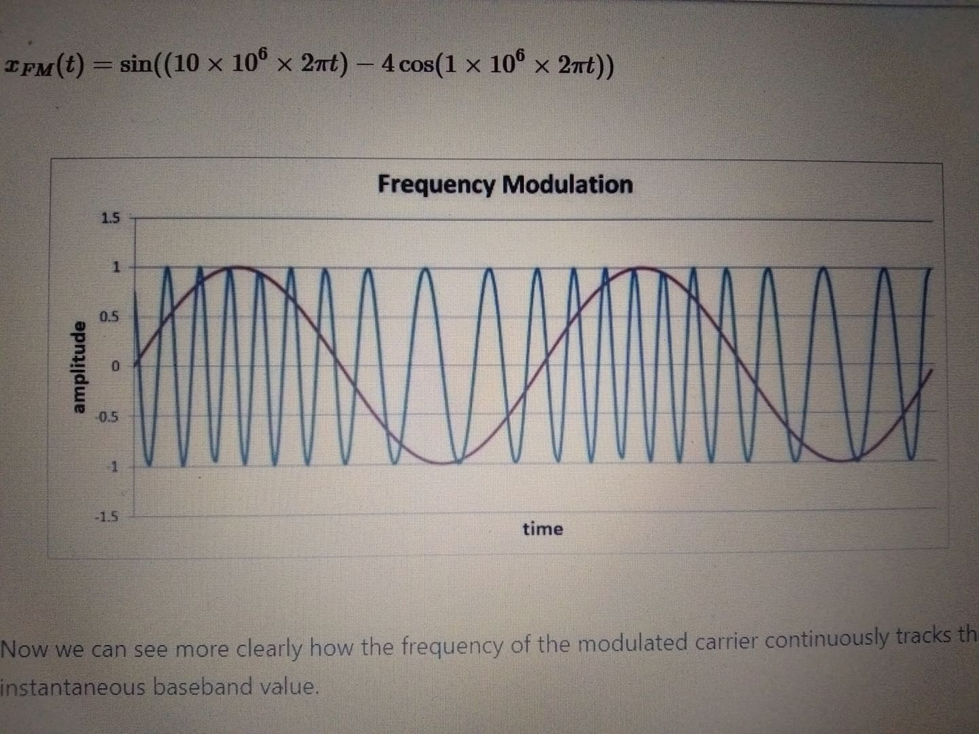
Modulation index=4

Slide 37
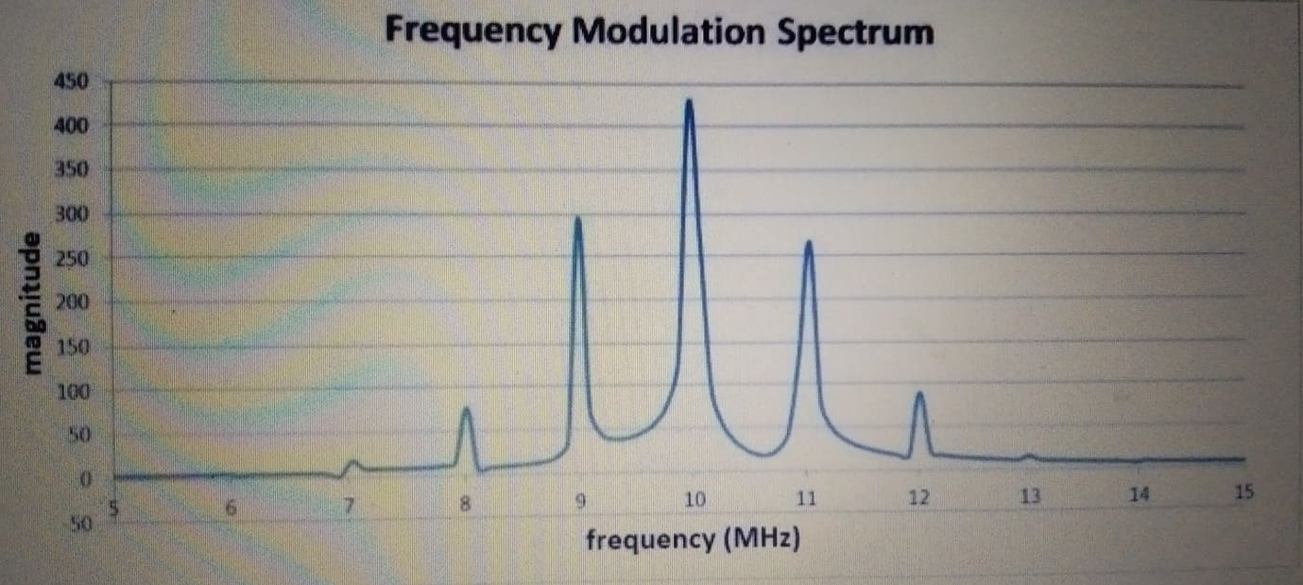
For single baseband frequency and m =1
It is the spectrum of the integral of the baseband signal that appears in the band surrounding the carrier frequency.

Slide 38
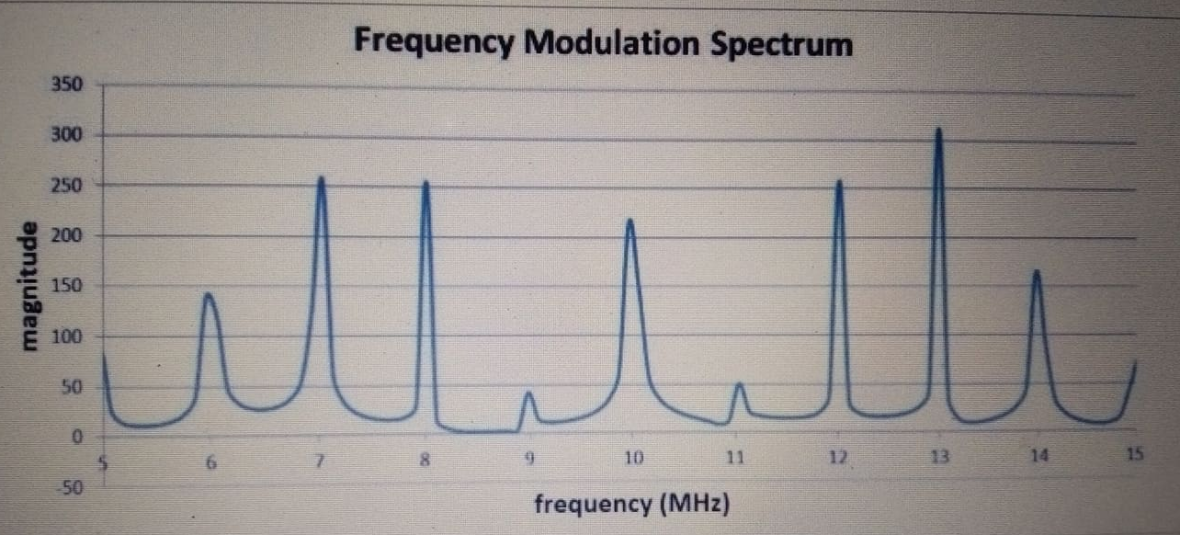
For single baseband frequency and m =4
It is the spectrum of the integral of the baseband signal that appears in the band surrounding the carrier frequency.

Slide 39
Summary of FM
The mathematical representation of frequency modulation consists of a sinusoidal expression with the integral of the baseband signal added to the argument of the sine or cosine function.
The modulation index can be used to make the frequency deviation more sensitive or less sensitive to variations in the baseband value.
An FM spectrum is influenced by the modulation index as well as by the ratio of the amplitude of the modulating signal to the frequency of the modulating signal.

